Slide 1
Flow Diagrams
By K Kevin Gladson
112210
cse-’b’

Slide 2
What is Flow Diaagram?
A flow diagram in UI/UX design, also known as a user flow or flowchart, visually represents the steps a user takes to accomplish a task within a system or interface. It's a schematic that maps out the paths users follow when interacting with a website, app, or product, showing various actions, decisions, and outcomes.

Slide 3
Why do we need Flow Diagrams??
Clarifies the User Journey: It visually maps out the steps users take, ensuring the design focuses on smooth, intuitive navigation.
Identifies Issues Early: By laying out interactions, flow diagrams help detect usability problems or inefficiencies before development begins.
Identifies Issues Early: By laying out interactions, flow diagrams help detect usability problems or inefficiencies before development begins.
Ensures Seamless User Experience: Flow diagrams help optimize the user path, reducing unnecessary steps and focusing on user goals for better usability.

Slide 4
What are the Steps to construct a Flow Diagram?
Understand the customer journey – who they are, their motivations, needs, behaviors etc. via a journey map.
2. Identify the goals and user’s goals – this makes conversions in the design according to theuser’s need.
3. Identify where your users are coming from – i.e., from direct traffic, organic search, social media, paid advertising, email, referral sites, press or news items using tools like Google Analytics.
4. Identify the information the visitor needs – via User Persona, Journey map etc. this helps in knowing their problem, their doubts and hesitations etc.
5. Visualize your User Flow – using the flow diagram. This includes various the entry and exit point, various task they perform with the product or service, conditional navigations etc.,
6. Prototype the flow – using wireframes, UI mockups to test the user flow throughout the product.
7. Review, Refine, and Test – the flow diagram is shared with the stakeholders for feedback and are refined. It is shared with the users for testing and continue evolving at the feedbacks.

Slide 5
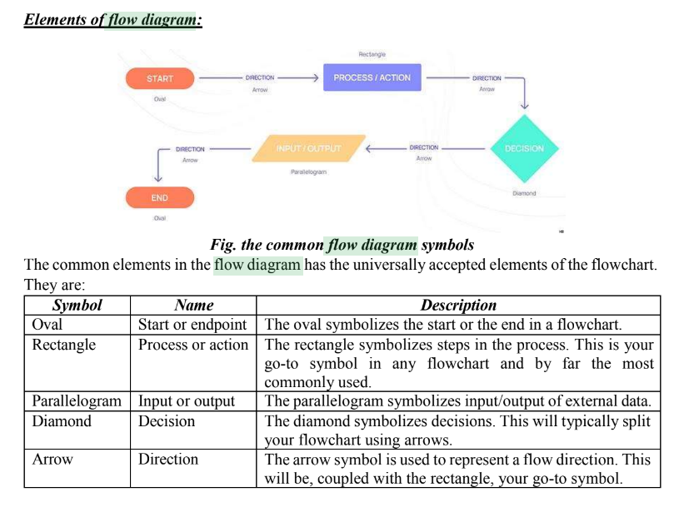

Slide 6
What are the Mistakes to Avoid in flow Diagram?
Avoid making assumptions on user’s perceptions and needs – assumptions on user following path on the services (linear path).
Avoid including too much detailing.
Avoid using ambiguous or confusing language

Slide 7
Thank You

